Slide 1
Predicting Tag of Questions & Data Science Job Required Skill Analysis
Stevens institute of technology, Spring 2017, cs - 513

Slide 2



Projects By:
Priya Parmar
Ruchika Sutariya
Harsh Kevadia
10412380
10418975
10420312

Slide 3
Agenda
Problem Statement
Objective
Project Flow
Data Scraping
DataSet After Scraping
Cleaning Data
Classification Models
Conclusion

Slide 4
What is Career Cup ?
CareerCup helps people prepare for jobs at tech companies.
Unlike other types of interviews, technical interviews are intensely skill based.
So what CareerCup does -- it offers you ways of studying for an interview.
You can ask questions for the interview prep.
You can post questions that were asked to you in your interview to help others.

Slide 5
Problem Statement
Some users don’t put tags in their questions.
This leads to questions with ambiguous categories.
It becomes a cumbersome process to decide what questions belong to which category manually leading to increase in human work load.
There has to be a way to categorize these questions that don’t have tags/categories.

Slide 6
Objective
We are focusing on predicting category of questions based on their properties.
We are considering previous questions, their votes and their tags for the categorization of those questions.
The main aim of this project is to predict the category of questions by using the previously categorized questions leading to less human work load.

Slide 7
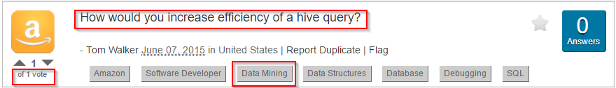
An Example ..

Slide 8
Project Flow
Understanding the Problem
Data Scraping
Algorithm Selection
Data Cleaning
Test Different Classification Models
Compare Model Accuracy
Best Model Selection

Slide 9
Data Scraping
Web sites are written using HTML, which means that each web page is a structured document.
Data scraping is the practice of using a computer program to sift through a web page and gather the data that you need in a format most useful to you while at the same time preserving the structure of the data.
So we used a Python program to scrap through the CareerCup website to get a real time dataset.

Slide 10
After Scraping Data
The format that we get after scraping:
TAG \t VOTE \t Question
Example:
algorithm 3 Given the root of a Binary Tree along with two integer values. Assume that both integers are present in the tree. Find the LCA (Least Common Ancestor) of the two nodes with values of the given integers. 2 pass solution is easy. You must solve this in a single pass.
TAG
VOTE
Question

Slide 11
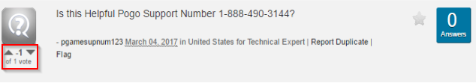
Cleaning Data
Removing the questions with negative votes to improve the quality of the dataset.
For each question, we use text mining to remove stop words (like is, the, etc) from the question.

Slide 12
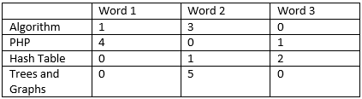
Process - Convert Raw Questions to the matrix

Slide 13
Extracting words
Words are extracted in two ways:
Question is split by spaces to get individual words.
A fixed length of 5 characters is used to define a word.

Slide 14
Classification Models Used
KNN
Decision Tree
Logistic Regression
Random Forest
Naive Bayesian
ANN

Slide 15
KNN
Supervised method - Where a target variable is specified – The algorithm “learns” from the examples by determining which values of the predictor variables are associated with different values of the target variable.
K-nearest neighbors is a simple algorithm that stores all variable cases and classifies new cases based on a similarity measure.
It has been used stastically estimation.

Slide 16
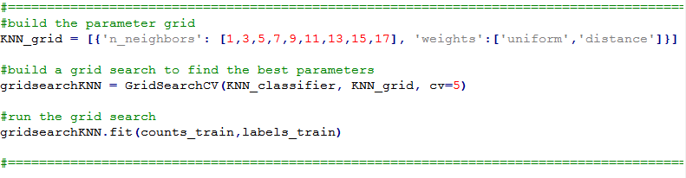
KNN Parameters

Slide 17
Output
{'n_neighbors': 1, 'weights': 'uniform'} 0.7670329670329671
{'n_neighbors': 1, 'weights': 'distance'} 0.7670329670329671
{'n_neighbors': 3, 'weights': 'uniform'} 0.7772893772893773
{'n_neighbors': 3, 'weights': 'distance'} 0.7714285714285715
{'n_neighbors': 5, 'weights': 'uniform'} 0.8131868131868132
{'n_neighbors': 5, 'weights': 'distance'} 0.8043956043956044
{'n_neighbors': 7, 'weights': 'uniform'} 0.8278388278388278
{'n_neighbors': 7, 'weights': 'distance'} 0.819047619047619
{'n_neighbors': 9, 'weights': 'uniform'} 0.8263736263736263
{'n_neighbors': 11, 'weights': 'uniform'} 0.8293040293040294
{'n_neighbors': 13, 'weights': 'distance'} 0.8197802197802198
{'n_neighbors': 15, 'weights': 'uniform'} 0.8336996336996337
{'n_neighbors': 17, 'weights': 'distance'} 0.8219780219780219
Accuracy: 0.8336996336996337

Slide 18
Decision Tree

Slide 19
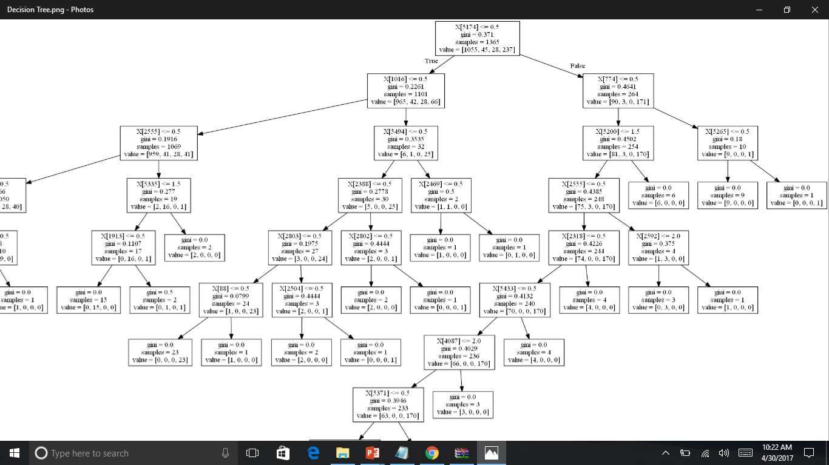
Decision Tree

Slide 20
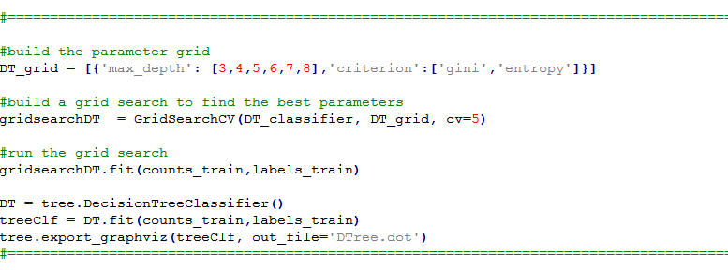
DT Parameters

Slide 21
Output
{'criterion': 'gini', 'max_depth': 3} 0.8586080586080586
{'criterion': 'gini', 'max_depth': 4} 0.8622710622710623
{'criterion': 'gini', 'max_depth': 5} 0.8666666666666667
{'criterion': 'gini', 'max_depth': 6} 0.8593406593406593
{'criterion': 'gini', 'max_depth': 7} 0.8578754578754578
{'criterion': 'gini', 'max_depth': 8} 0.8556776556776556
{'criterion': 'entropy', 'max_depth': 3} 0.8549450549450549
{'criterion': 'entropy', 'max_depth': 4} 0.863003663003663
{'criterion': 'entropy', 'max_depth': 5} 0.8695970695970696
{'criterion': 'entropy', 'max_depth': 6} 0.8681318681318682
{'criterion': 'entropy', 'max_depth': 7} 0.8652014652014652
{'criterion': 'entropy', 'max_depth': 8} 0.8593406593406593
Accuracy: 0.8695970695970696

Slide 22
Logistic Regression
It is a classification method that generalizes logistic regression to multiclass problems, i.e. with more than two possible discrete outcomes
It is used to predict the probabilities of the different possible outcomes of a categorically distributed dependent variable, given a set of independent variables

Slide 23
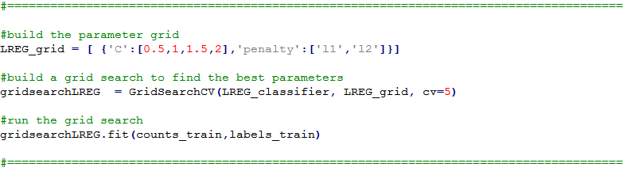
LR Parameters

Slide 24
Output
{'C': 0.5, 'penalty': 'l1'} 0.8293040293040294
{'C': 0.5, 'penalty': 'l2'} 0.8307692307692308
{'C': 1, 'penalty': 'l1'} 0.8315018315018315
{'C': 1, 'penalty': 'l2'} 0.8315018315018315
{'C': 1.5, 'penalty': 'l1'} 0.8300366300366301
{'C': 1.5, 'penalty': 'l2'} 0.832967032967033
{'C': 2, 'penalty': 'l1'} 0.8278388278388278
{'C': 2, 'penalty': 'l2'} 0.8322344322344323
Accuracy: 0.832967032967033

Slide 25
Random Forest
Random forest (or random forests) is an ensemble classifier that consists of many decision trees and outputs the class that is the mode of the class's output by individual trees.
It Operates by constructing many decision trees

Slide 26
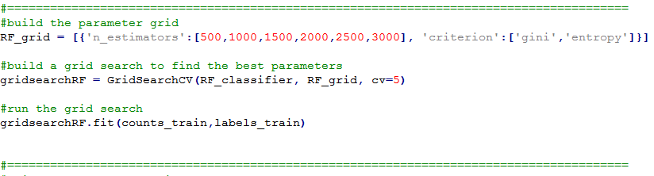
RF Parameters

Slide 27
Output
{'n_estimators': 500, 'criterion': 'gini'} 0.8468864468864469
{'n_estimators': 1000, 'criterion': 'gini'} 0.8498168498168498
{'n_estimators': 1500, 'criterion': 'gini'} 0.8468864468864469
{'n_estimators': 2000, 'criterion': 'gini'} 0.8461538461538461
{'n_estimators': 2500, 'criterion': 'gini'} 0.8490842490842491
{'n_estimators': 3000, 'criterion': 'gini'} 0.8476190476190476
{'n_estimators': 500, 'criterion': 'entropy'} 0.8446886446886447
{'n_estimators': 1000, 'criterion': 'entropy'} 0.8454212454212454
{'n_estimators': 1500, 'criterion': 'entropy'} 0.8424908424908425
{'n_estimators': 2000, 'criterion': 'entropy'} 0.8454212454212454
{'n_estimators': 2500, 'criterion': 'entropy'} 0.8454212454212454
{'n_estimators': 3000, 'criterion': 'entropy'} 0.8424908424908425
Accuracy: 0.8498168498168498

Slide 28
Naive Bayesian
It is a classification technique based on Bayes' Theorem with an assumption of independence among predictors.
In simple terms, a Naive Bayes classifier assumes that the presence of a particular feature in a class is unrelated to the presence of any other feature.
A Naive Bayesian model is easy to build, with no complicated iterative parameter estimation which makes it particularly useful for very large datasets.

Slide 29
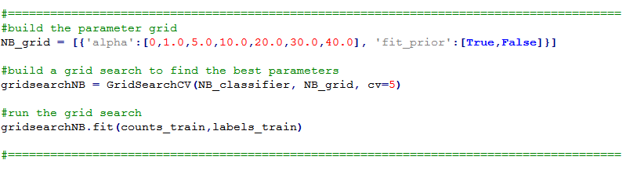
NB Parameters

Slide 30
Output
{'alpha': 0, 'fit_prior': True} 0.7970695970695971
{'alpha': 0, 'fit_prior': False} 0.7919413919413919
{'alpha': 1.0, 'fit_prior': True} 0.7934065934065934
{'alpha': 1.0, 'fit_prior': False} 0.7736263736263737
{'alpha': 5.0, 'fit_prior': True} 0.802930402930403
{'alpha': 5.0, 'fit_prior': False} 0.8131868131868132
{'alpha': 10.0, 'fit_prior': True} 0.780952380952381
{'alpha': 10.0, 'fit_prior': False} 0.7992673992673993
{'alpha': 20.0, 'fit_prior': True} 0.7736263736263737
{'alpha': 20.0, 'fit_prior': False} 0.7846153846153846
{'alpha': 30.0, 'fit_prior': True} 0.7743589743589744
{'alpha': 30.0, 'fit_prior': False} 0.7846153846153846
{'alpha': 40.0, 'fit_prior': True} 0.7743589743589744
{'alpha': 40.0, 'fit_prior': False} 0.7831501831501831
Accuracy: 0.8131868131868132

Slide 31
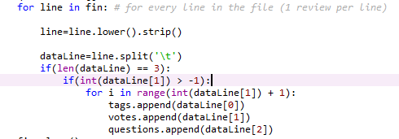
ANN - Artificial Neural Networks
Highest Accuracy
Accuracy: 0.916256157635

Slide 32
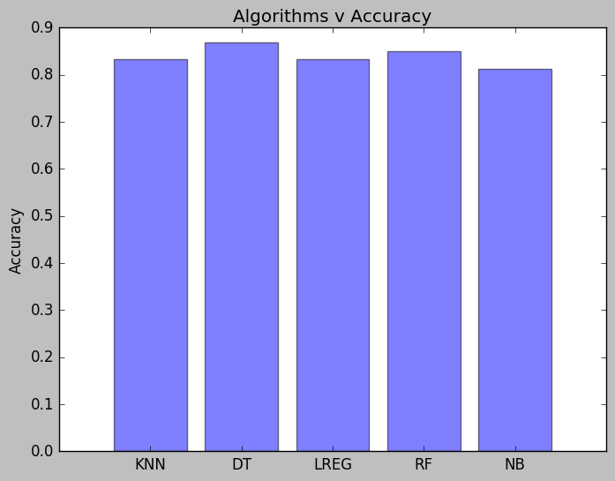
Comparison of Classification models

Slide 33
Conclusion
We have explored different prediction models. By measuring the performance of the models using real data, we have seen interesting results on the predictability of the category of questions.
We found out that ANN has the maximum accuracy for predicting the Career Cup dataset.

Slide 34
Future Scope
Currently we are using 4 categories for prediction. But in future, this can be extended to hundreds of categories with a satisfactory accuracy.
In future, we can add a categorization for the question according to the company as well. For example, what kind of questions are asked for Amazon or Google could be predicted.

Slide 35
References
http://www.careercup.com
https://www.wikipedia.org/

Slide 36
Data Science Job Required Skill Analysis

Slide 37
Data Science Job Analysis - Monster.com
Total Jobs: 450
Total Python Skill Jobs: 200
Python Percentage: 44.44%
Total Big Data Skill Jobs: 153
Big Data Percentage: 34.00%
Total SAS Skill Jobs: 61
SAS Percentage: 13.56%
Total R Skill Jobs: 128
R Percentage: 28.44%
Total Machine Learning Skill Jobs: 153
Machine Learning Percentage: 34.00%

Slide 38
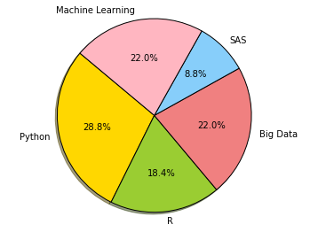
Result:

Slide 39
Thank You
Question & Answer

